Slide 1
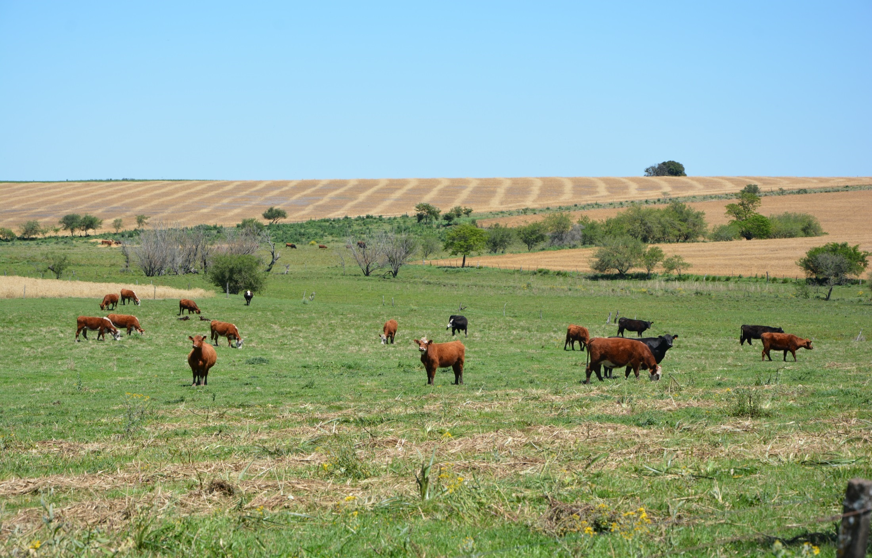
Digital Agriculture in Uruguay
Lessons Learned
OLC-KPOK KNOWLEDGE EXCHANGE
ON DIGITAL AGRICULTURE TECHNOLOGY
Seoul, 26-30 August 2019
Amalia Álvarez
Miguel Sierra
Julieta Souza
Katie Kennedy

Slide 2
SMART AGRICULTURE
Key takeways
Awareness about potential transformation of DAT
Increase productivity
Control of environmental impact
Food safety
Coordination (private, public and others sectors)
Applied experiences of DAT in different countries
Impressive development of Korea applying DAT

Slide 3
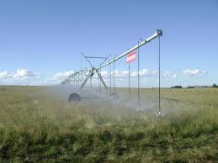
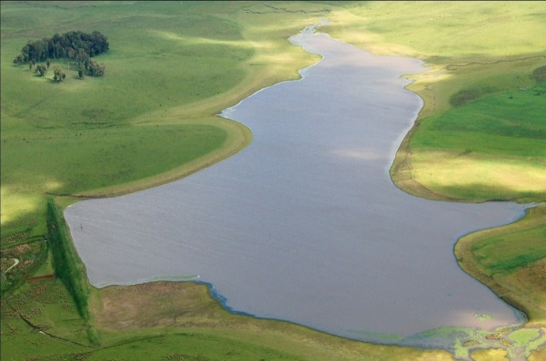
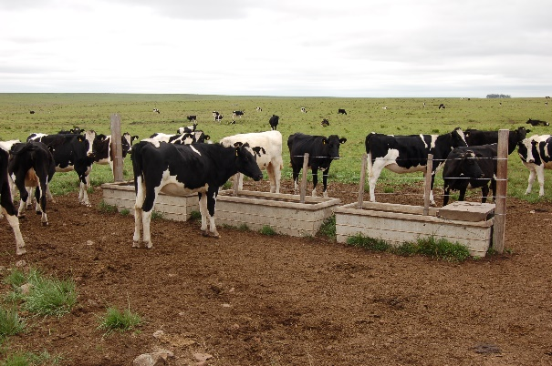
SMART AGRICULTURE
Uruguayan challenges
Agri Awareness
DAT
Sustainability
IoT – Controlled environment agricultura
Precision Agriculture
Safety Food
Blockchain for value chain
Traceability
Adaptation to climate change
Weather index insurance
Remote sensing
Efficient use of natural resources
Remote sensing
Internet of Plants
Precision Agriculture

Slide 4
SMART AGRICULTURE
Action Plan
1 to 3 years
App available for Farmers
Consolidation of SNIA
3 to 5 years
Big Data Agro system
Knowledge Exchange Center in UY
5 to 10 years
AgTech ecosystem working efficiently
Training of young people with DAT
Model center of Smart Farm
Strengthen capacities at all levels
Promotion of DAT Projects in the private sector (DACC Project)
Promote ecosystem of Smart Farms with local deveolpments for early adoption
Implementation of Carbon Navigator
“Uruguay Natural” as Brand of safety and sustainable food with Smart production and social responsability
Cultural change in agri food sector more atracted to younger people
Value chain holistic approach from the farmer to consumer (Smart eco turism, cooperative structure)

Slide 5
SMART AGRICULTURE
Opportunities and Barriers
Barriers
Human capital (capacity, aging, quantity)
Fragmentation (institutional, data, public-private)
Resources
Opportunities
Natural production conditions.
Uruguay Software houses.
“Plan ceibal” - One laptop per child program.

Slide 6
SMART AGRICULTURE
Resources needed
International collaboration for knowledge exchange.
Technical support
Smart farm,
DAT application (IA, Agriculture Big Data Center, knowledge center).
Financial resources for capacity creation (people training, knowledge center).

Slide 7
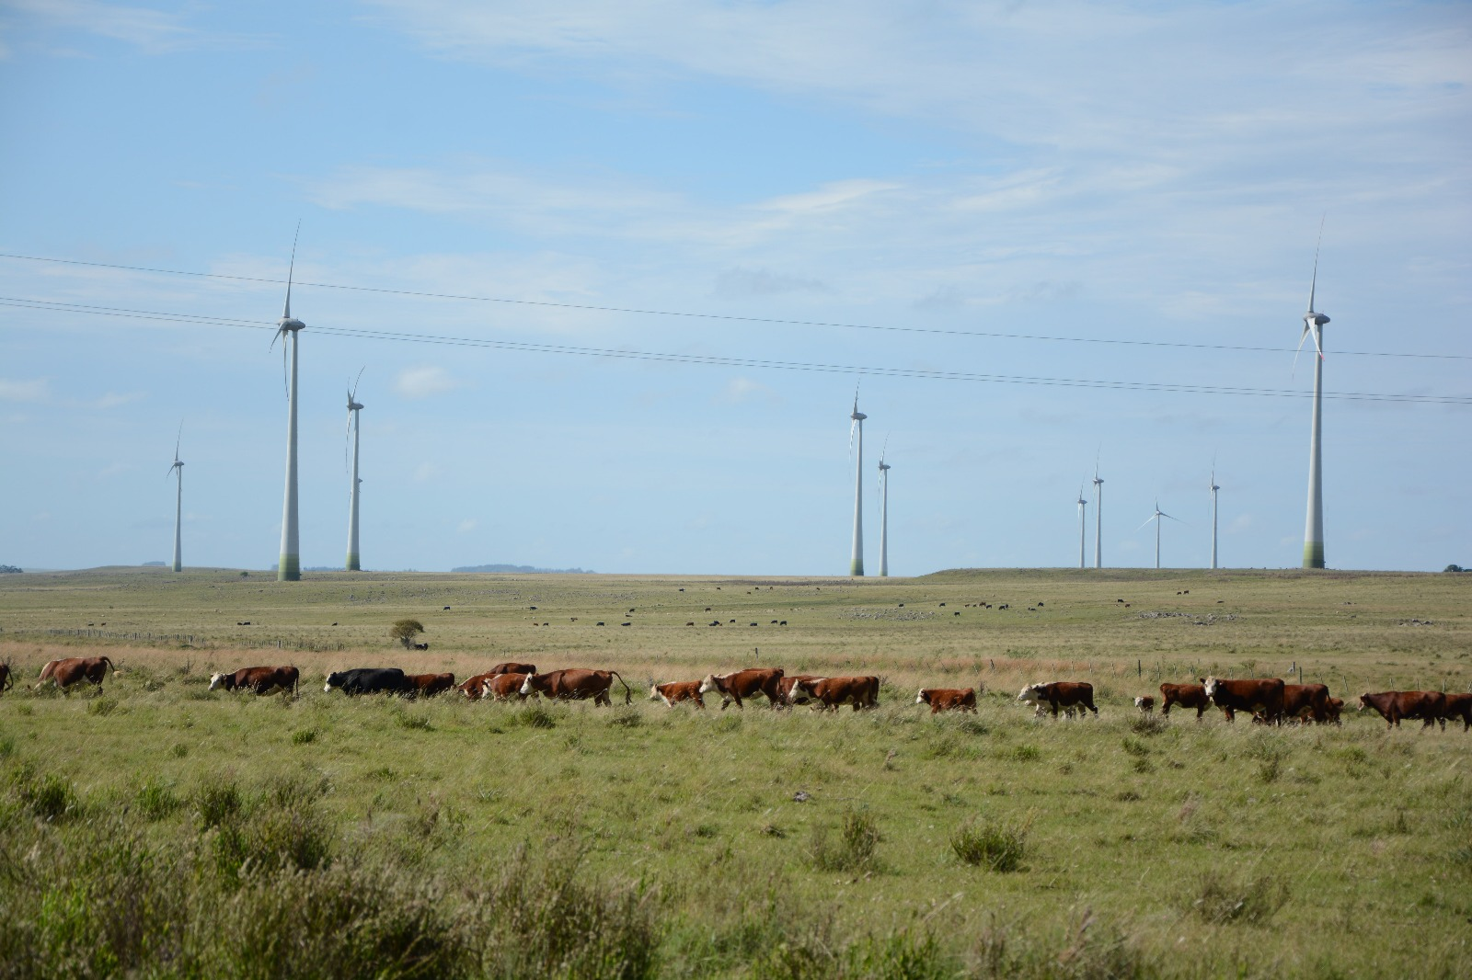
Thank you.
OLC-KPOK KNOWLEDGE EXCHANGE
ON DIGITAL AGRICULTURE TECHNOLOGY
Seoul, 26-30 August 2019
Amalia Álvarez
Miguel Sierra
Julieta Souza
Katie Kennedy

